Slide 1


FROM POTATO TO CHIPS, FROM STEEL TO PIPE
Why finished products cannot be priced as raw material
A simple transformation story to explain pipe pricing.
Core idea: raw material is only one input. Finished pipe price includes conversion, testing, standards, risk, inventory, logistics and supplier margin.
Raw input
Finished product
₹40/kg
₹599/kg
Do not compare only the kilograms. Compare the value state.
Notes:
Open with the potato and chips example. The objective is not food pricing. The objective is to reset engineering thinking: finished pipe price is a certified, processed, risk-managed product price, not merely steel weight multiplied by raw steel rate.

Slide 2
PRICE SHOCK
The first comparison looks shocking, but it is incomplete
15x
raw price vs retail price
This is a useful attention grabber, but it mixes two different bases: fresh raw input and packaged retail output.
₹40/kg
₹599/kg
Raw potato price uses the ₹40/kg screenshot. Chips price uses the ₹599/kg screenshot.
Notes:
Engineers often do the same with pipe estimates: raw steel rate per kg is compared directly with finished pipe quote. The comparison creates outrage but not insight. Correct analysis requires a common basis.

Slide 3
ENGINEERING CORRECTION
Mass balance changes the economics
1.0 kg raw potato
high water content
Slice + fry
water removed, oil added
~0.30 kg chips
illustrative yield
Packaged snack
brand + retail channel
→
→
→
₹180
₹40
4.5x
₹140
retail value of 0.30 kg chips
raw potato input cost
value multiple after yield correction
price spread on 1 kg potato input
1 kg potatoes does not become 1 kg chips. A fair comparison first converts both sides to a common mass and value basis.
Notes:
This slide is the engineering turn. It introduces a mass balance. With 30 percent yield, one kilogram of potatoes produces only about 0.30 kg chips. At ₹599 per kg chips, the retail value of the output from one kg potatoes is about ₹180, not ₹599.

Slide 4
VALUE BRIDGE
For 1 kg finished chips, raw potato is only part of the price
Illustrative ₹/kg finished chips
₹133
Potato input after yield
₹45
Oil, salt, ingredients
₹70
Processing, energy, labor
₹65
Quality, wastage, packaging
₹55
Logistics and working capital
₹231
Brand, retail, tax, margin
Total
₹599/kg
The price gap is not only “profit.” It includes transformation, assurance, distribution and market access.
Numbers are illustrative. The logic matters more than the exact potato market price.
Notes:
Use this bridge to show that raw input value is the base, not the full product price. The finished price carries all steps needed to make the product usable, safe, saleable and available to the customer.

Slide 5
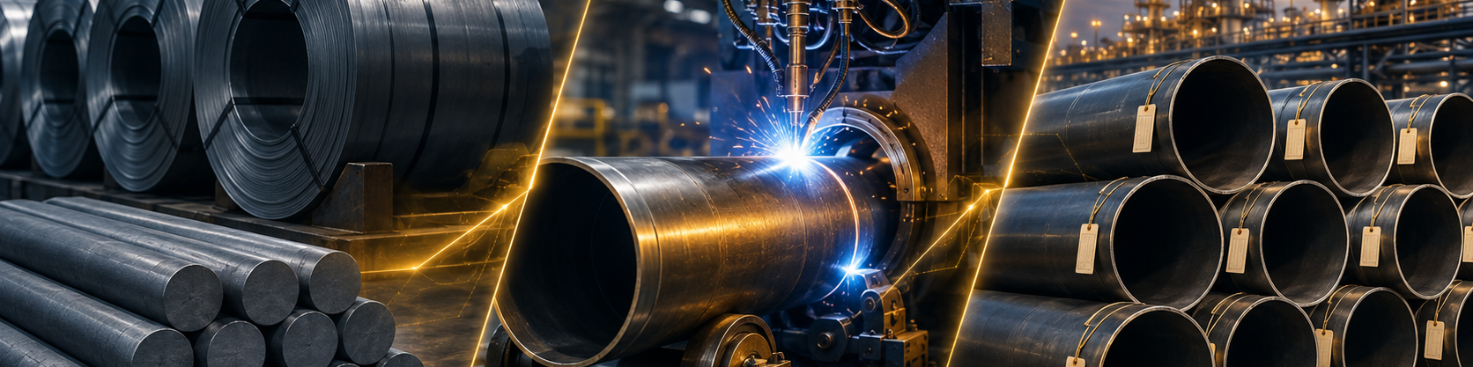
STEEL TO PIPE
The same logic applies to pipe procurement
Raw steel
coil, plate, billet
Forming
seamless or welded route
Heat treatment
mechanical properties
Testing
NDT, hydro, PMI, MTC
Supply
coating, docs, logistics
→
→
→
→
Finished pipe is an engineered, certified, inspected and deliverable product. Steel is only the starting material.
Notes:
This is the direct bridge from the food analogy to engineering. It shows that pipe cost is created through process route, specification, assurance and delivery readiness.

Slide 6
HIDDEN COST DRIVERS
Why raw steel rate is a weak estimator for pipe price
Specification
grade, PSL, standard, service, traceability
Geometry
NPS, schedule, wall thickness, tolerances
Manufacturing route
seamless, ERW, HFW, SAW, forging
Quality assurance
NDT, hydrotest, PMI, MTC, ITP, TPI
Surface protection
coating, painting, end preparation
Market & supply chain
MOQ, lead time, inventory, freight, margin
Engineering blind spot: a pipe is not priced by metal weight alone. The specification decides the conversion premium and risk premium.
Notes:
Walk through each driver with an example from refinery work. A small specification change can move a quote more than a raw material price movement.

Slide 7
PIPE PRICE LOGIC
A practical value bridge for finished pipe
Finished pipe price =
Raw steel cost
adjusted for yield
Conversion route
forming + welding
Heat treatment
properties + tolerances
Inspection package
NDT + hydro + MTC
Commercial load
freight + working capital + margin
+
+
+
+
kg × steel rate
kg × steel rate + premium model
conversion premium library by spec
bad estimate
better estimate
best capability
Build an internal premium library: NPS, schedule, material grade, route, test level, coating and supplier lead time.
Notes:
This converts the discussion from complaint to capability. The objective is to create a repeatable estimating model, not to debate every quotation manually.

Slide 8
ESTIMATION DISCIPLINE
What engineers should ask before challenging a pipe quote
1
What is the common basis?
kg, metre, piece, NPS, schedule, material, standard
2
What transformation is required?
seamless or welded route, heat treatment, machining, coating
3
What assurance is demanded?
NDT, hydrotest, PMI, MTC, TPI, ITP, traceability
4
What supply risk is priced?
MOQ, lead time, freight, inventory, financing, market scarcity
5
Can we benchmark the premium?
historical PO, market quote, vendor breakup, internal cost model
This changes the conversation from “why so costly?” to “which value drivers explain the premium?”
Notes:
This slide can be used as a discussion checklist in engineering review. It helps junior engineers challenge quotes with evidence, not emotion.

Slide 9
CEO MINDSET
The leadership takeaway
Raw material is an input. Specification converts it into enterprise value.
For engineers: estimate the transformation, not just the metal.
For procurement: ask for quote structure and benchmark conversion premium.
For management: build a governed price intelligence capability.
Next practical experiment
Take 20 recent pipe POs. Split price into raw steel equivalent, conversion premium, testing and logistics. Create a reusable benchmark table by NPS, schedule, material and specification.
Outcome: better estimates, better negotiations, fewer surprises before procurement.
Notes:
Close by making it practical. A pipe price intelligence table creates organizational capability: repeatable, auditable and scalable beyond one person.

